Slide 1
Transfer Apprenticeship Levy Mark Coulson National Account Manager

Slide 2
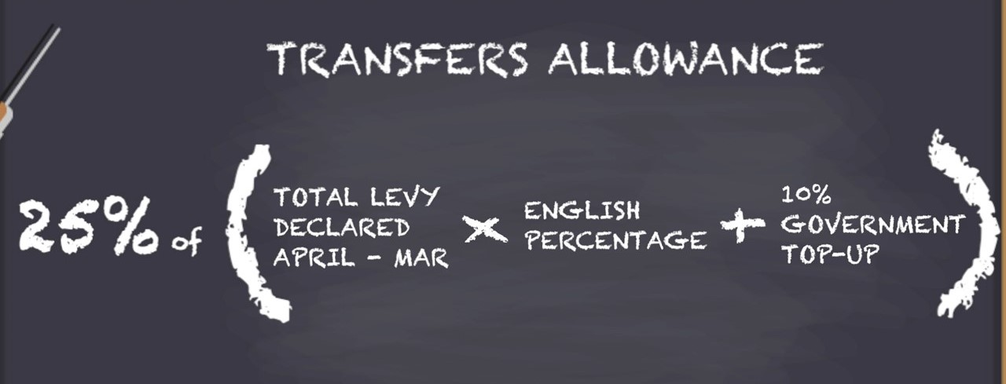
What is a Levy Transfer?
As an employer paying the apprenticeship levy you have an allowance, 25% of your annual apprenticeship funds, that can be transferred to other employers.
• Only levy-paying employers can make a transfer
• Any employer can receive and use transferred funds

Slide 3
Why Transfer Apprenticeship Levy?
To use Levy locally
Channel your apprenticeship funds to organisations in your supply chain.
Corporate Social Responsibility (CSR)
Add to the skills in the local talent pool

Slide 4
Preparing for a Levy Transfer
Understanding of the forecasted cost to you, which will cover the duration of the apprenticeship you’ve agreed to fund through a transfer
Funding the total cost of their apprenticeship and not just the co-investment
Funding rules around transferring apprenticeship funds
Can’t transfer funds to another employer if you currently receive a transfer
Transfer payments will leave your apprenticeship service account first, each month

Slide 5
How a Levy Transfer Works?
• Funds are paid monthly for the duration of the apprenticeship
• Sending and receiving employers have to be registered on the apprenticeship service
• A transfer can only be used to pay for training and assessment for apprenticeship standards
• Transfers can only be used for new starts

Slide 6
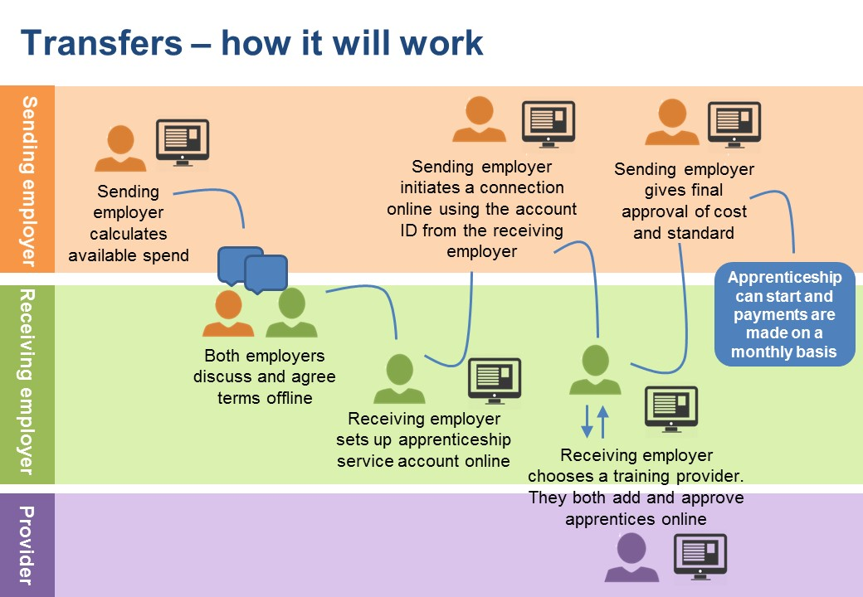
How a Levy Transfer Works?

Slide 7
Employer Case Study 1
Sending Employer – Wolverhampton City Council
Receiving Employer - Wolverhampton Homes
Wolverhampton Homes look after more than 23,000 homes on behalf of The City of Wolverhampton Council and are also a very pro-active community-based organisation.
Supported 11 employees to progress onto L3 & L5 Management Apprenticeships.
Wolverhampton Home have supported over 100 tenants into permanent employment, and some of those have also benefited from the apprenticeship transfer.
Michelle’s Story

Slide 8
Employer Case Study 2
Sending Employer – Royal Mail Group
Receiving Employer – North West Ambulance Service
300+ apprentices registered as an employer-provider delivering the level 4 Associate Ambulance Practitioner since May 2017. in co-investment since July 2018,
Submitted a request through Health Education England (HEE) for a partner willing to transfer unspent apprenticeship funds. Royal Mail Group were interested in partnering with us
This will allow us to continue to invest in our apprenticeships, without the loss of funding associated with co-investment.
Also supporting Royal Mail on their journey to become an employer-provider.

